Slide 1

Exploratory Data Analysis
Customer Segmentations
10th Aug 2021

Slide 2
Background – Customer Segmentation
Objective: XYZ bank wants to roll out Christmas offers to their customers. But Bank does not want to roll out same offer to all customers instead they want to roll out personalized offer to particular set of customers. If they manually start understanding the category of customer then this will be not efficient and also they will not be able to uncover the hidden pattern in the data ( pattern which group certain kind of customer in one category). Bank approached ABC analytics company to solve their problem. Bank also shared information with ABC analytics that they don't want more than 5 group as this will be inefficient for their campaign.
Contents of this Presentation
Data Exploration and Cleaning
Analysis
Findings
Recommendations

Slide 3
Data Exploration
Final Dataset
85023 observations
9 columns
Actions Performed
Handling outlies and null values
Z Score Method
Mean method
Changing Appropriate dtypes
Changing column names and observations from Spanish to readable English
Selected appropriate features for modeling

Slide 4
NA Values and Outliers
Few observations which have null values are overlapping, i.e same records have missing values in all columns have been removed.
The columns ult_fec_cli_1t and conyuemp have 99% null values so the best action would be to drop these two columns. The renta column represents the gross income of the family, and has about 17% of null values, these null values can be replaced by the average of column. There are null values in other columns but they amount to around 1% of the dataset so I have decided to remove them from the dataset.
Replaced nulls in renta column with average value
Outliers in gross income and age column have been identified using a box plot and have been removed based on their z-score.
Features are selected based upon the relevance of the column and the type of data.Most of the binary data is removed only important columns are retained as binary data doesnt work well with Clustering algorithms.

Slide 5
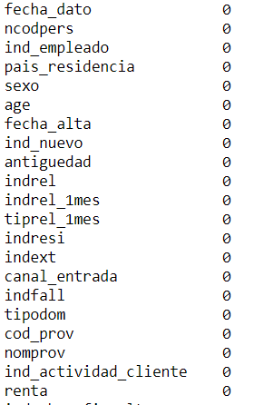
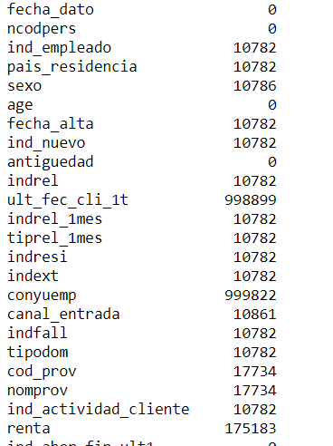
NA Values
Before
After

Slide 6
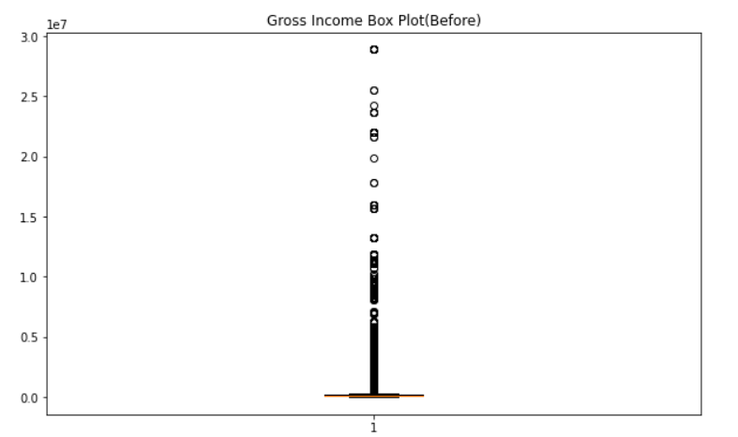
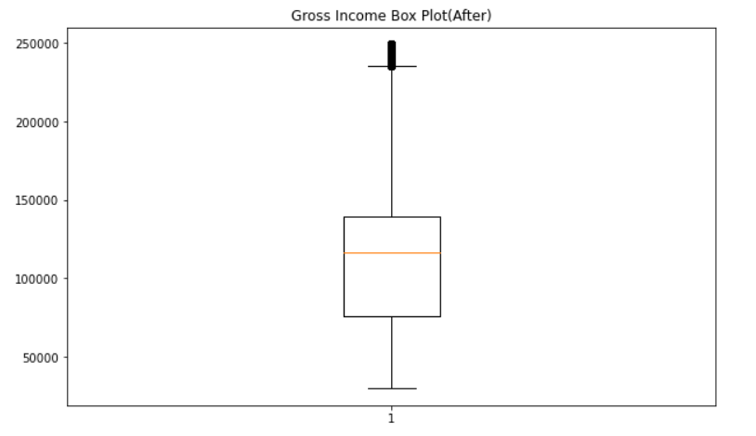
Outliers(Using z-score)

Slide 7
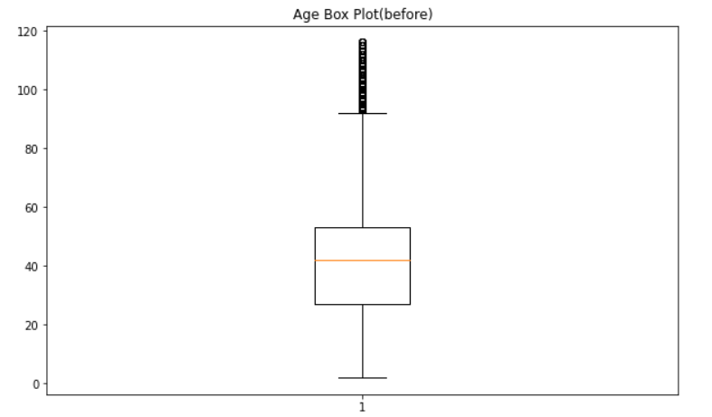
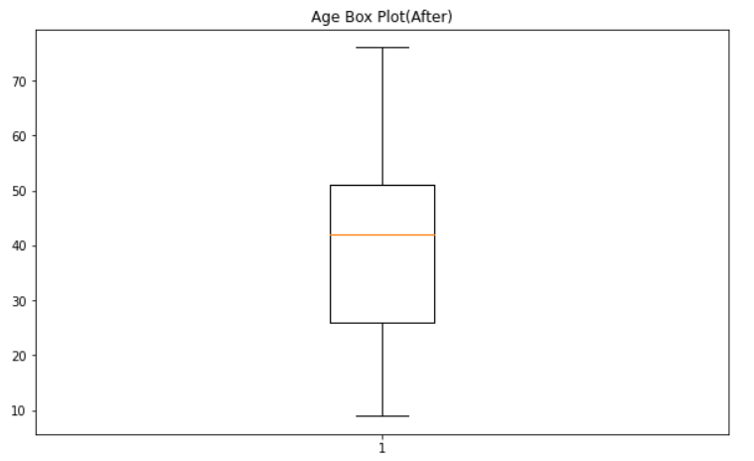
Outliers(Using z-score)

Slide 8
General Observations
Employee Index values
N : 981145 A : 285 F : 282 B : 385 S : 2
Country values
ES : 982089 IT : 4 DE : 2 BO : 2 PY : 2
Customer Type values
1 : 982095 2 : 2 3 : 2
These column will not be very useful in clustering, as they will introduce bias, and can thus be removed.

Slide 9
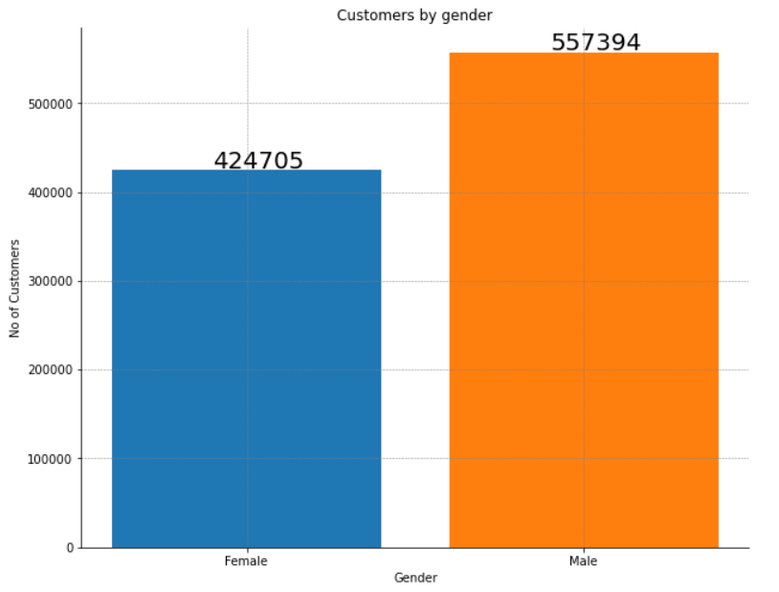
General Observations

Slide 10
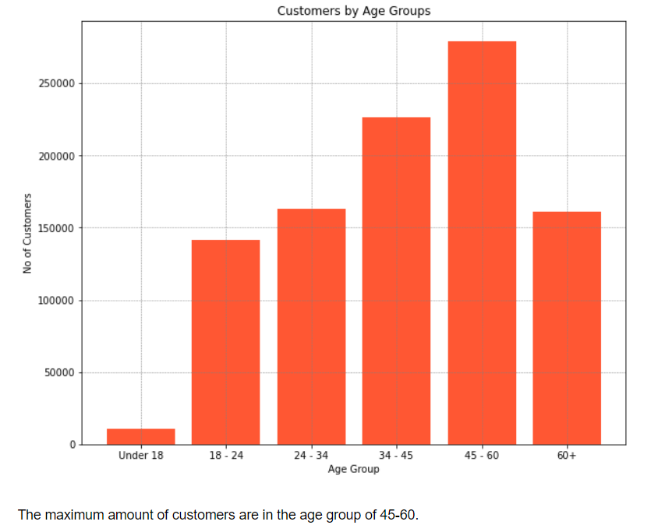
General Observations

Slide 11
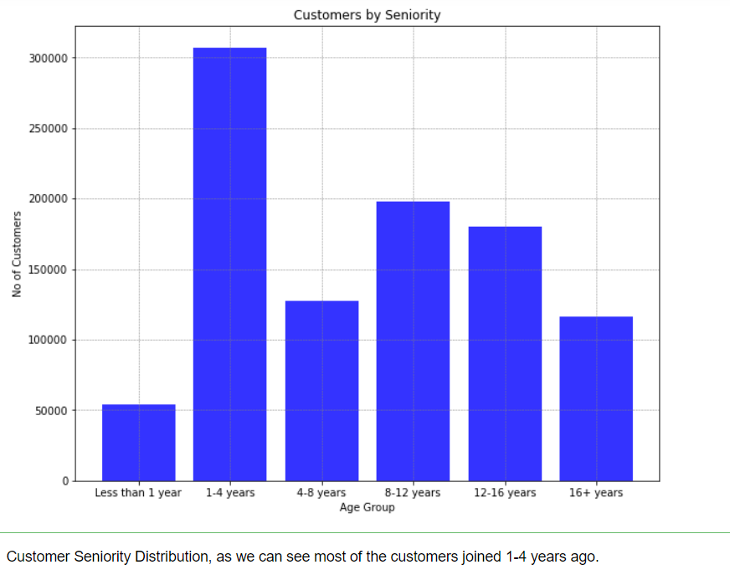
General Observations

Slide 12
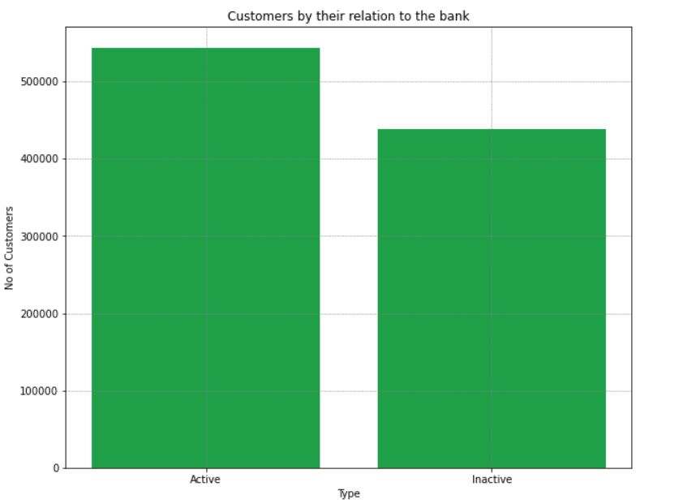
General Observations

Slide 13
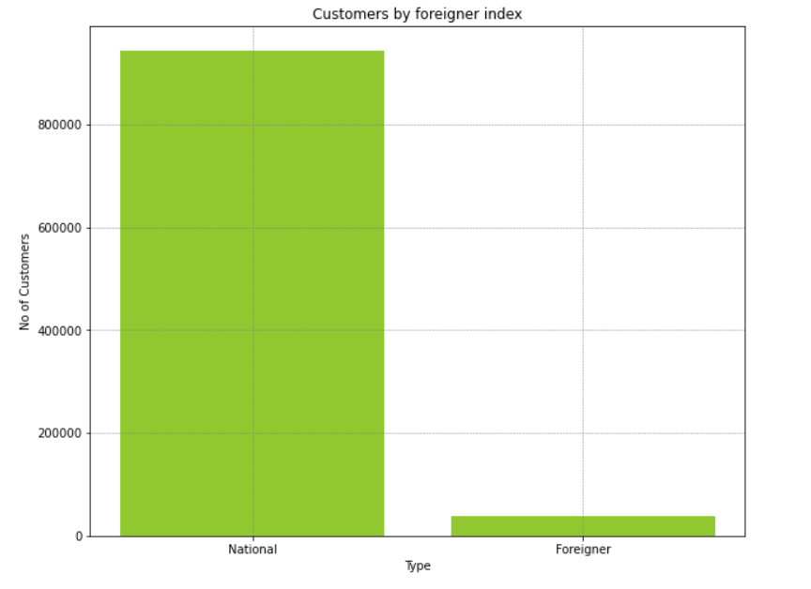
General Observations

Slide 14
Recommendation
Finally our data has been cleaned and all outliers and NA values have been dealt with.
The columns we have chosen are relatively balanced and will be good for modeling
A clustering model can be created on the given dataset to divide customers into segments for targeted promotions.
The best algorithm to use would be the K-means algorithm

Slide 15

Thank You

